Slide 1
Regression Analysis
Poisson Regression
Nicoleta Serban, Ph.D.
Professor
Stewart School of Industrial and Systems Engineering
Data Examples

Slide 2

About This Lesson

Slide 3
Data Example 1: High School Awards
Objective: To model and predict the number of awards earned by students for multiple high schools.
Response Variable: The number of awards earned by students at a high school per year.
Predicting Variables:
The type of program in which the student was enrolled, with three levels: 1 = "General", 2 = "Academic" and 3 ="Vocational"; and
The score on the final exam in math.
Acknowledgement: This data example was acquired from the Institute for Digital Research and Education at University of California, Los Angeles.

Slide 4
Exploratory Data Analysis
## Read data in R
awardsdata = read.csv("students_awards.csv",header=T)
## Convert qualitative variable in the data into factor in R
awardsdata = within(awardsdata, {
prog = factor(prog, levels=1:3, labels=c("General", "Academic", "Vocational"))
id = factor(id)})
## Conditional histograms
library(ggplot2)
ggplot(awardsdata, aes(num_awards, fill = prog)) + geom_histogram(binwidth=.5, position="dodge")

Slide 5
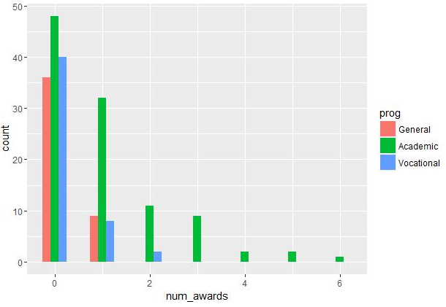
Exploratory Data Analysis

Slide 6
Data Example 2: Insurance Claims
Objective: To explain factors that are associated to car insurance claims due to accidents or other events leading to car damage.
Response Variable: The number of car insurance claims per policyholder:
Holders: numbers of policyholders; and
Claims: numbers of claims
Predicting Variables:
District of residence of policyholder (1 to 4): 4 is major cities.
Classification of cars with levels <1 litre, 1–1.5 litre, 1.5–2 litre, >2 litre.
Age group of the policyholder: <25, 25–29, 30–35, >35.

Slide 7
Exploratory Data Analysis
## Data in the R library MASS
library(MASS)
summary(Insurance)
## Relationship between rate of claims and predictors
boxplot(Claims/Holders~District, xlab = "District", ylab = "Rate of claims per policyholder",data=Insurance)
boxplot(Claims/Holders~Group, xlab = "Group", ylab = "Rate of claims per policyholder",data=Insurance)
boxplot(Claims/Holders~Age, xlab = "Age", ylab = "Rate of claims per policyholder",data=Insurance)

Slide 8
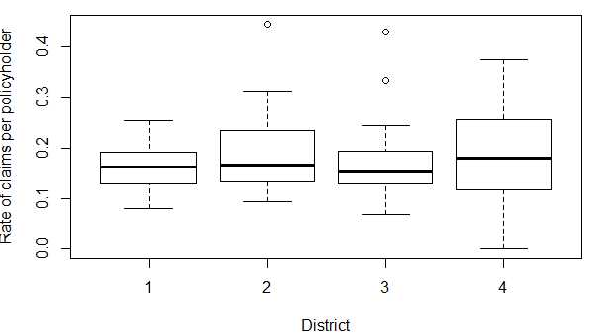
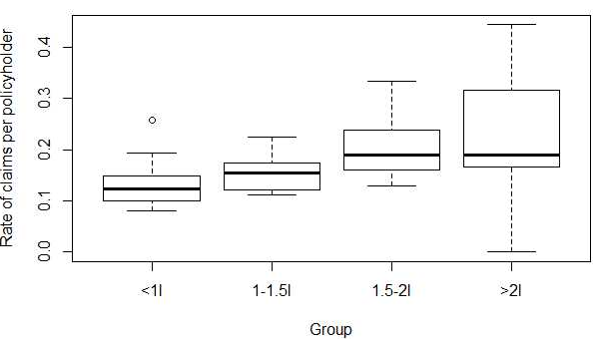
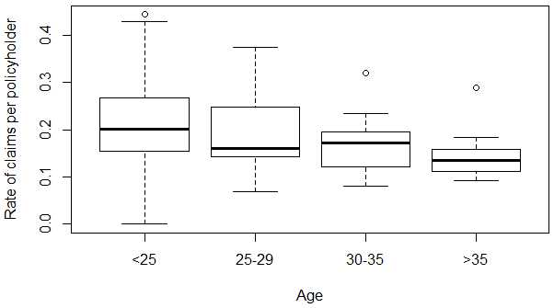
Exploratory Data Analysis

Slide 9

Summary

